Slide 1
Cognitive Modelling
Assignment 1
Presentation of Cognitive Model
Student Number: 92277837
Name: Paul McGuinness
Email: Paulmcguinness99@gmail.com

Slide 2
Approach to the Training Data
Major initial assumptions
The approach taken in the model is to assume that individuals will act in a broadly rational way by attempting to extract whatever “Information” is available in each dimension in the data;
The Information in each dimension may be strongly or weakly positive, negative or ambiguous and the individual will effectively identify the dimension that gives the strongest signal and then consider if the other two dimensions add to or subtract from the signal provided in the first dimension;
Assumptions that evolved from the model
What was not clear at the outset was:
A) how information within a dimension would be extracted and
B) how negative signals would be interpreted.
As a result a number of approaches (labelled T1, T2, T3 and T4) were initially used in the single category model to see how sophisticated an approach was taken to extract the “Information” from the data and the one that provided the highest correlation was adopted

Slide 3
Approach to the Training Data (continued)
T1: Percentage Occurrence (“P.O.”) in Category only
For example in Dimension 1 of Category A there are 3 “A” values out of 4 so the score for A in Dim one would be 75% (multiplied by 10 to get a score out of 10)
T2: P.O. in a Category less P.O. not in the Category (“N.I.C.”)
For example in Dimension 1 of Category A as noted above there is a 75% occurrence of “A” in the Category, however there is an 8% (1 out of 12) occurrence in the instances that are N.I.C.-A, so the T2 score would be 67% (75%-8%)
T3: T2 but treat negatives as zero
Similar to T2 but if a dimension returns a negative score for a Category a zero is used in the overall assessment. For example in Dimension 1 of Category A there is no “Z” however there are 2 “Z” values N.I.C.-A out of 12. T2 would return -17%, however in the case of T3 this is returned as a 0
T4: T2 but cap score at the T2 score for the broader Category
This is relevant for Category A and B only as they have a broader category. For Category C this will return the same as T2
For example as noted above the T2 score for “A” in Dimension 1 of Category A was 67%. In the broader Category there are 4 “A” values out of 6 in Category and zero “A” values N.I.C, thus also a score of 67% so the T2 score would not be reduced

Slide 4
Application to the Test Data – Single Category
The scores for T1 to T4 for each dimension in the table above have been reordered so the highest score over the 3 dimensions is in the first panel (Max) etc.
The final panel show the sum of the T1 to T4 scores across the three dimensions and the correlation to the average participant score is shown in the final panel (Sum)
This scoring indicates that on average the participants have been quite sophisticated in extracting the information inherent in the Training Data as the highest correlation (86.9%) is with the most sophisticated approach to data extraction.

Slide 5
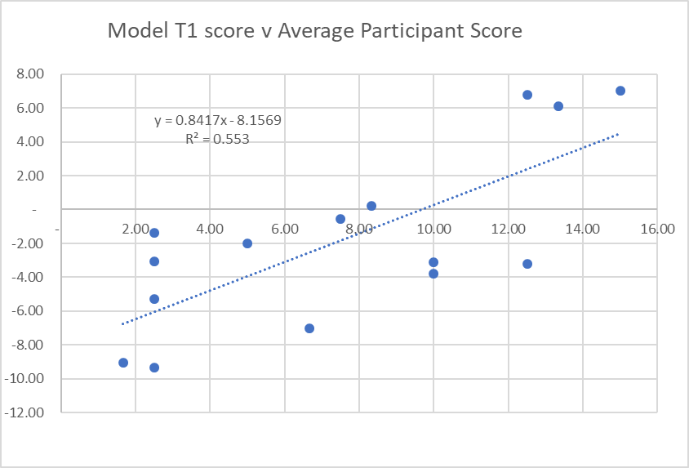
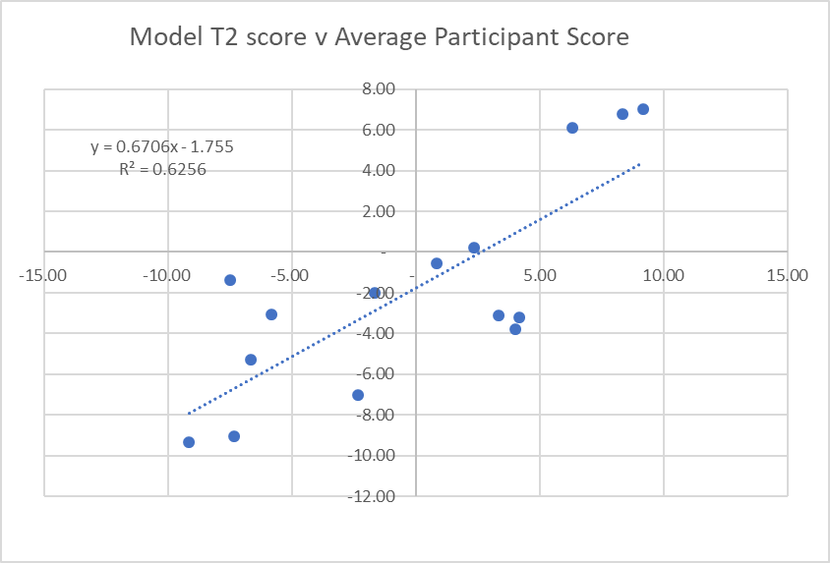
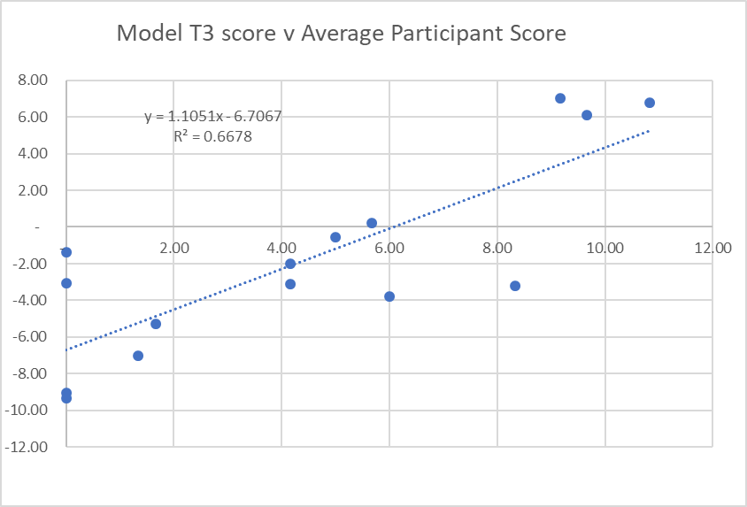
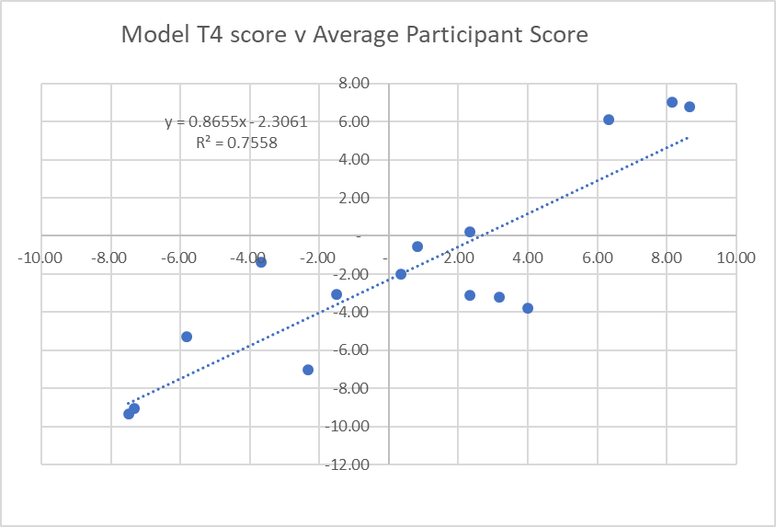
Graphs T1 to T4 – Single Category

Slide 6
Conjunctive Category – Actual Data & Prototypes
Given the high correlation of the T4 score in the single category to the average participant scores the approach to the conjunctive category was to try to replicate this approach as much as possible
However as we are now considering the “Broader” category there is no Broader category limitation so the closest calculation to the T4 score that can be done is a T2 score on the actual data.
There is a limited amount of actual information for an A&B conjunction so an actual score can be calculated (table below) which is not the case for A&C or B&C.
Thus a prototype category must be constructed and where the actual score is available it is simply averaged with the score from the prototype of the conjunctive category created from the individual categories.

Slide 7
Conjunctive Category – Prototype & Negative signals Type 1
The starting point for constructing the Prototype is the single category T2 scores shown earlier
In creation of the Prototype it was considered necessary to be nuanced about how to treat negative signals from the data – there are 2 types of cases which are incorporated into the model.
Type 1 concerns a situation where a symptom does not occur in one of the categories but is a strong indicator of the other. In this case it is assumed the participant will discount the negative signal on the basis that the strong indication of the first category has effectively “overridden” the signal from the second category.
T2 score for symptom A in single Category B
As 6.7 is the highest positive for Category 1, the negative score for Category 2 is ignored in calculating T9
Sum of T9 for category 2 is now 1.7 (4.2 less 2.5)
T2 score for symptom A in single Category A

Slide 8
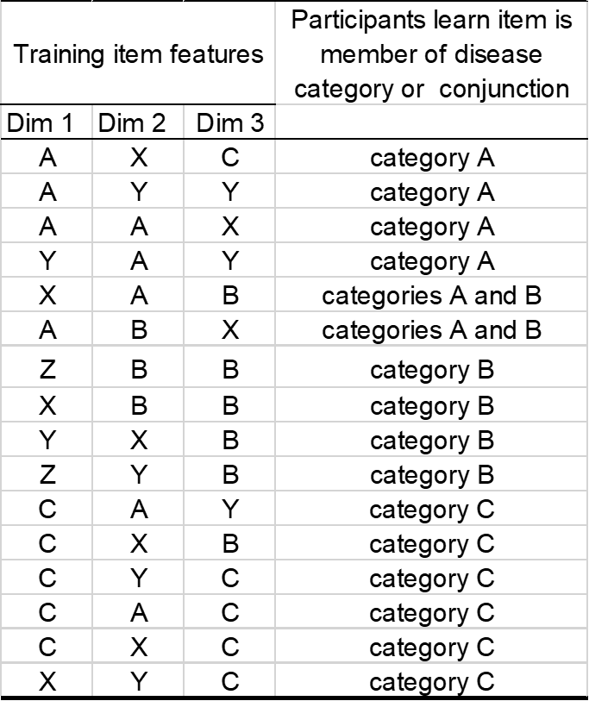
Conjunctive Category – Prototype & Negative signals Type 2
Type 2 negative signals concern a situation where a symptom does not occur in either of the 2 individual conjunctive categories, this was considered to be a very strong negative signal that would register with participants.
For example “B” occurs in Dimension 2 in case A&C1 below but does not occur in the training data connected with A or C. We have dealt with this by (somewhat arbitrarily) assigning a score of -3.3 (being to max negative of 10 divided over 3 dimensions) when it occurs. This is referred to in the model as the T8 score

Slide 9
Conjunctive Category – Merging scores
The previous 3 pages have calculated 4 different scores:
The T2 scores for the actual observed category A&B training data
The T9 score for each category in the conjunctive pair
The T8 score to accommodate the rare instance of a symptom not appearing in either conjunctive category
The following process was used to merger the data
The lower of the two T9 scores was chosen (Min T9) – this is because the chance of both categories in the pair cannot be greater than the chance of one of them individually
Where there was a T8 score (always negative) this was taken from Min T9 to give T10
Where actual T2 data from an observed conjunctive category existed (A&B) this was averaged with the T10 score based on the prototype on the basis that both approaches would be used and treated equally. The resulting T11 score is the model score for the conjunctive category

Slide 10
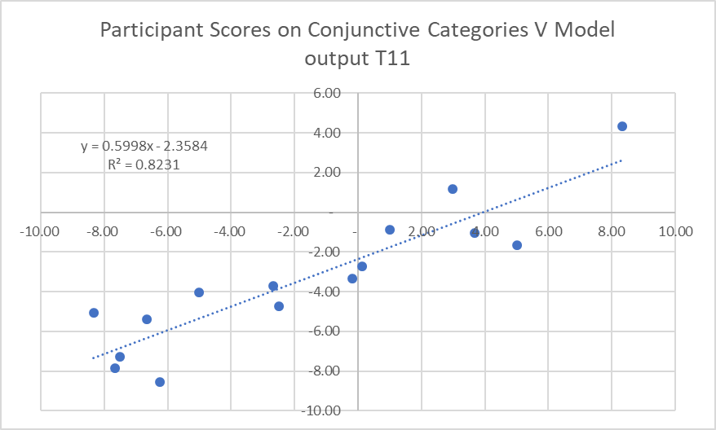
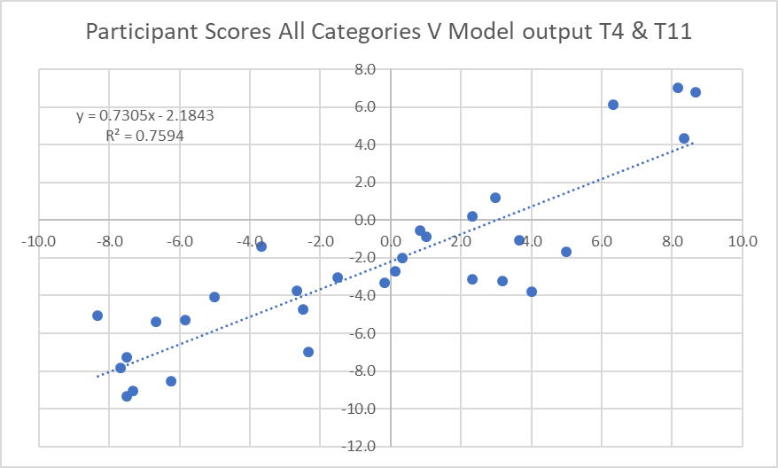
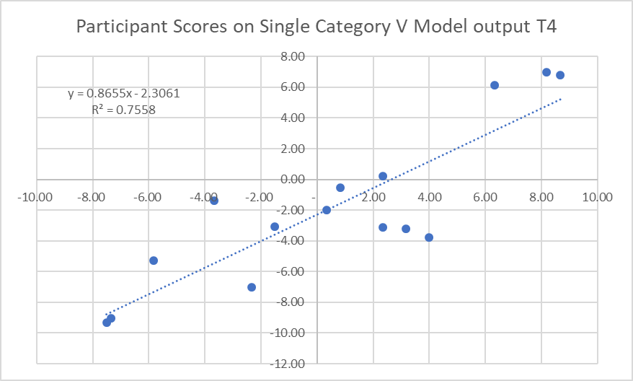
Conjunctive & Single Category - Graphs

Slide 11
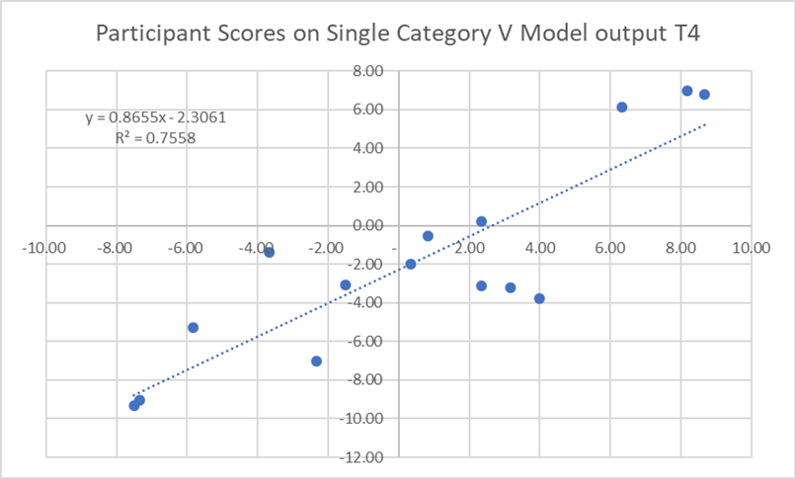
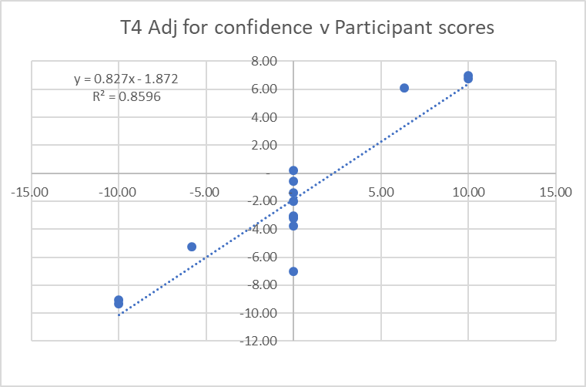
Observations – Individual confidence levels
Looking at individual participants data revealed a significant tendency towards over confidence in some individuals assessed by the number of scores of +/-10
This observation led to an suggested further amendment to the model to simply return a score of +/-10 when the model score was above a certain threshold (+/-7) and zero when below a certain threshold (+/-4).
As expected this increased correlation further from 86.9% for the single category data to 92.7% but this was ultimately disregarded as a function of the correlation calculation rather than being a meaningful adjustment

Slide 12
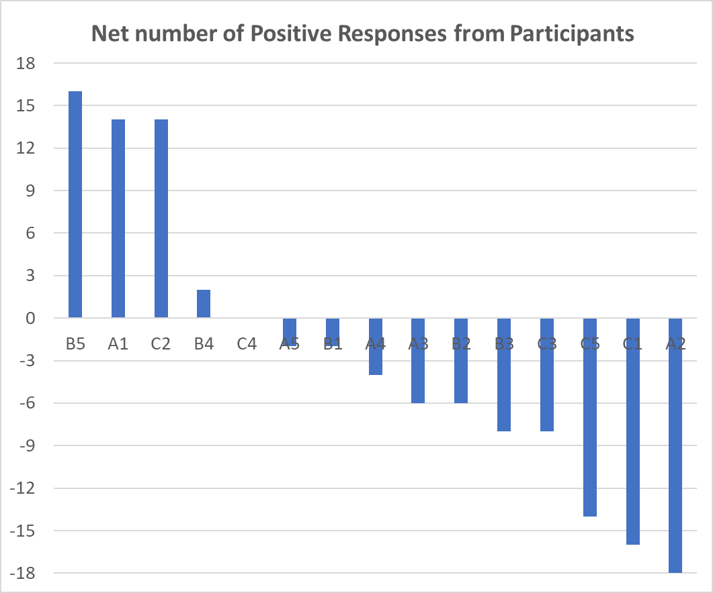
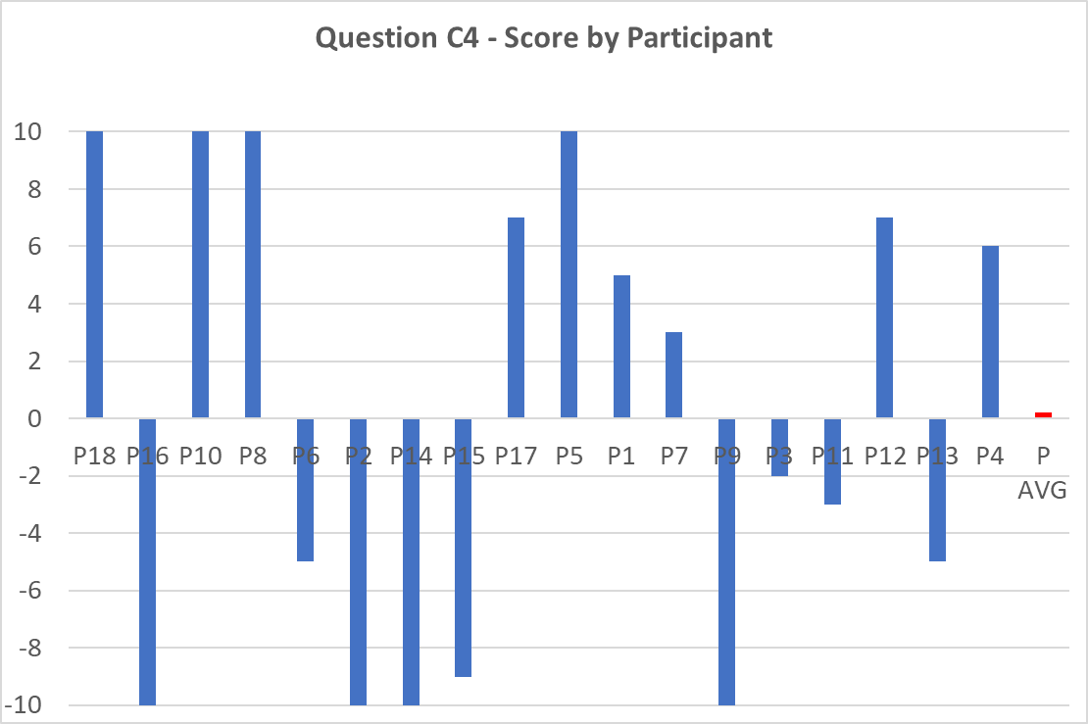
Observations – What is the model modelling?
Getting a model to correlate with the average answer to these questions should be trivially easy. (A score of +/-6 means 2/3rds of the participants agreed on the sign of the answer
Getting a model to correlate with the avg. answer to these question is more difficult but what is the point as it does not reflect any individual?

Slide 13
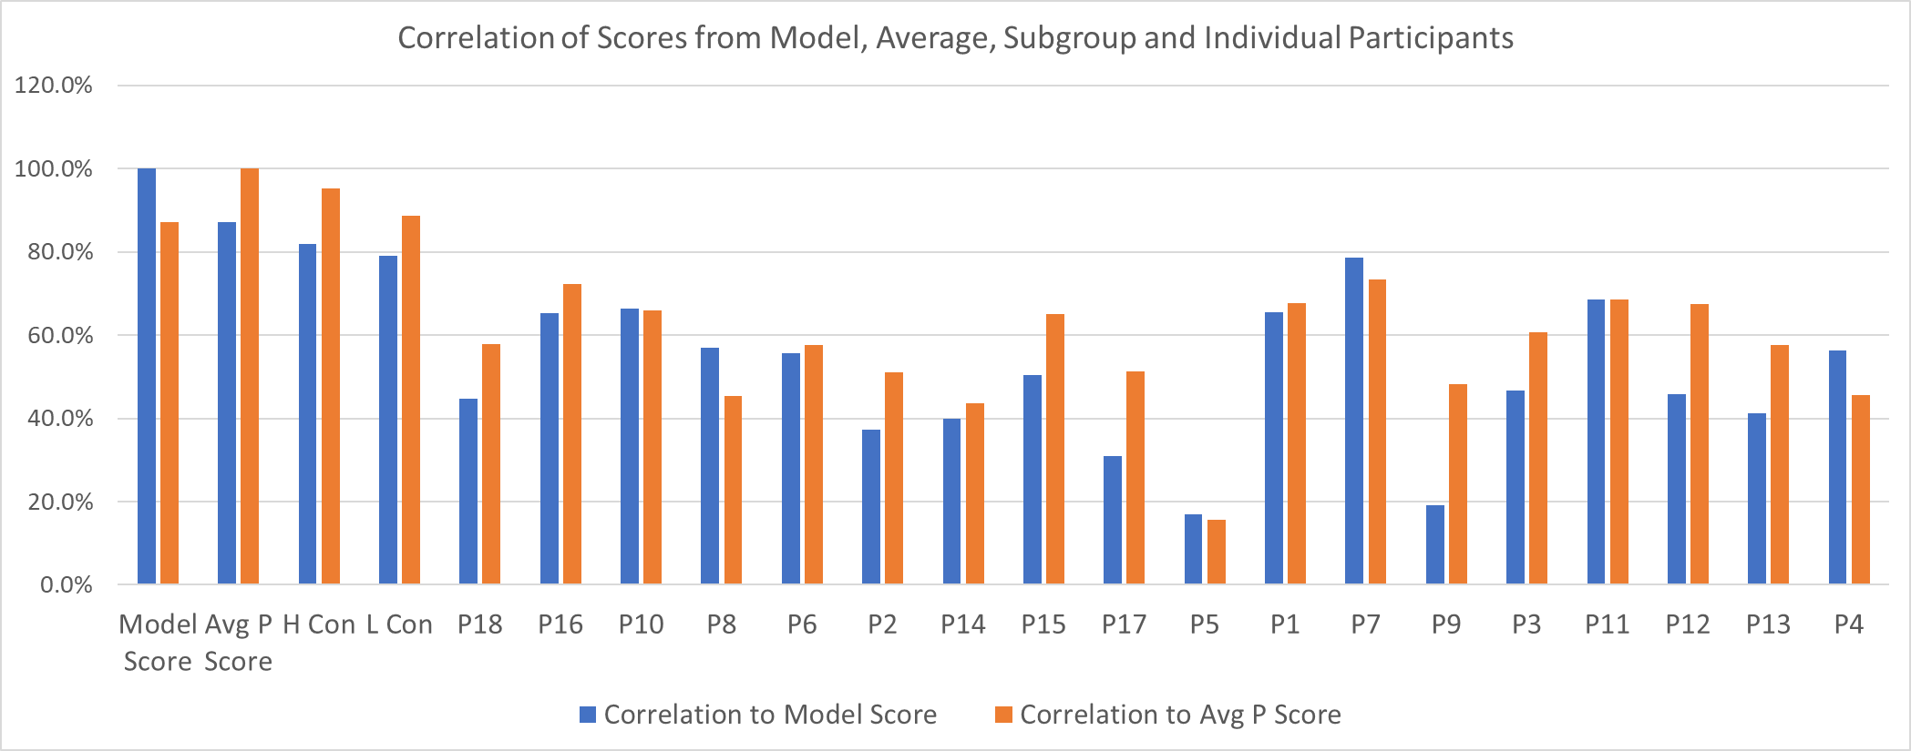
Observations – Individual v Group rationality
The model correlated highly with the average participants scores suggesting that the “average” approach taken by individuals was broadly rational and attempted to use all the information contained in the training set in some fashion;
A look at the correlation scores of individuals and sub categories of High confidence and Low confidence individuals (based on % of scores of +/-10) tells a different story suggesting that no individual was more rational than the average and perhaps more interesting no obvious subgrouping was more rational than the average.
This leads to the counterintuitive but inevitable conclusion that everyone is below average and that each of us exists to counterbalance an equal but opposite idiot on the other side of the distribution.

